Slide 1

Jupyter Notebooks, Arithmetic
LECTURE 03
Getting familiar with our computing environment, and
writing our first Python programs.
Spark 010 Spring 2024
Developed by students and faculty at UC Berkeley and Tuskegee University
data6.org/su23/syllabus/#acknowledgements-

Slide 2
Today’s Roadmap
Commenting code
Data types
Errors
Lecture 03, Spark 010 Spring 2024

Slide 3
Example: Incidence
1. Programming in Python
2. Arithmetic
3. Jupyter Shortcuts
4. Comments, Data Types, and Errors
➤

Slide 4
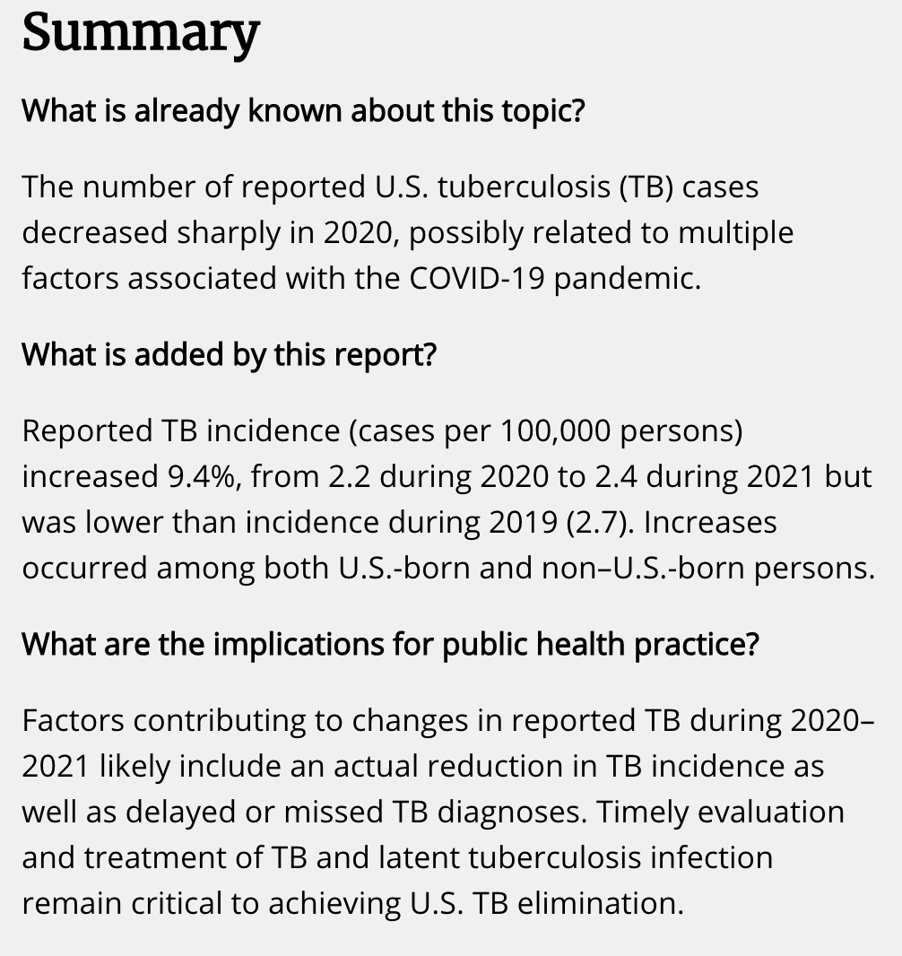

Tuberculosis – United States, 2021
CDC Morbidity and Mortality Weekly Report (MMWR) 03/25/2022.
What is incidence?
Why use it here?
How was “9.4% increase” computed?
Check out the source for data!

Slide 5
Incidence Rate
†TB incidence is computed as “Cases per 100,000 persons using mid-year population estimates from the U.S. Census Bureau.”
U.S. jurisdiction | No. of TB cases |  |  | TB incidence†
 | 2019 | 2020 | 2021 | 2019 | 2020 | 2021
Total | 8,900 | 7,173 | 7,860 | 2.71 | 2.16 | 2.37
Alabama | 87 | 72 | 92 | 1.77 | 1.43 | 1.83
… | … | … | … | … | … | …
California | 2,111 | 1,706 | 1,750 | 5.35 | 4.32 | 4.46
… | … | … | … | … | … | …
Use Python to validate these values:
2020 incidence
2021 incidence
 | 2019 pop | 2020 pop | 2021 pop
Total | 328,239,523 | 331,501,080 | 331,893,745
Alabama | 4,903,185 | 5,024,803 | 5,039,877
California | 39,512,223 | 39,499,738 | 39,237,836
CDC MMWR source
U.S. Census population estimates source (2019), source (2020-2021)

Slide 6
Congratulations!
You just wrote your first program.
🎉
# TB cases
def group: 100,000 people
TB incidence =
group
# TB cases
100,000 people
=
x
population (# people)
1 group
# TB cases
=
x
100,000
population
Incidence is useful when comparing case rates across differently sized populations.

Slide 7
Tuberculosis – United States, 2021
CDC Morbidity and Mortality Weekly Report (MMWR) 03/25/2022.
What is incidence?
Why use it here?
✅
How was “9.4% increase” computed?
To explore in lab!
Check out the source for data!

Slide 8
Comments, Data Types, and Errors
1. Programming in Python
2. Arithmetic
3. Jupyter Shortcuts
4. Comments, Data Types, and Errors
➤

Slide 9

Comments
Comments are used to explain what code does. Good programmers write code that is self-evident and use comments only where necessary. In assignments, we’ll also use comments to provide you with instructions.
Which version do you prefer?
A.
7173/(331501080/100000)
B.
7173/(331501080/100000) # 2020 U.S. TB incidence
C.
# 7173 ÷ (100,000 groups in 331,501,080 population)
7173/(331501080/100000)

Slide 10
Comments
Comments are used to explain what code does. Good programmers write code that is self-evident and use comments only where necessary. In assignments, we’ll also use comments to provide you with instructions.
Which version do you prefer?
You can have both code and comments on the same line.
Anything on a line after # is a comment and is not evaluated.
A.
7173/(331501080/100000)
B.
7173/(331501080/100000) # 2020 U.S. TB incidence
C.
# 7173 ÷ (100,000 groups in 331,501,080 population)
7173/(331501080/100000)

Slide 11
Common Python Operators
Operator | Symbol | Example Usage | Example Value
Addition | + | 2 + 3 | 5
Subtraction | - | 15 - 4 | 11
Multiplication | * | -2 * 9 | -18
Division | / | 15 / 2 | 7.5
Integer division Cuts off remainder | // | 15 // 2 | 7
Remainder/Modulo | % | 19 % 3 | 1 19 ÷ 3 = 6 Remainder 1
Exponentiation | ** | 3 ** 2 | 9
✅

Slide 12
Common Python Operators
Operator | Symbol | Example Usage | Example Value
Addition | + | 2 + 3 | 5
Subtraction | - | 15 - 4 | 11
Multiplication | * | -2 * 9 | -18
Division | / | 15 / 2 | 7.5
Integer division Cuts off remainder | // | 15 // 2 | 7
Remainder/Modulo | % | 19 % 3 | 1 19 ÷ 3 = 6 Remainder 1
Exponentiation | ** | 3 ** 2 | 9
Wait, why are there two division operators?

Slide 13
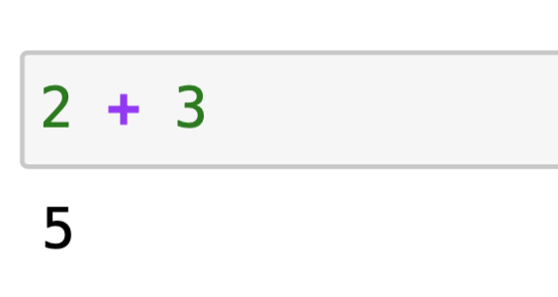
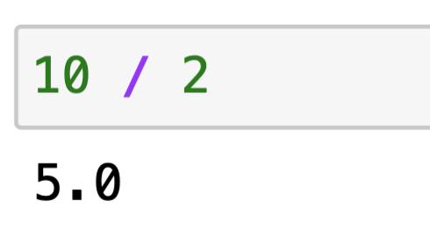
Data Types
We glossed over something earlier:
The data type of a value determines how Python evaluates expressions involving that value
There are two different number data types to represent numbers in Python:
Integers (int)
“Whole numbers” (positive, negative, 0)
Floating Points (float)
Anything with a decimal point, even if everything after the decimal point is 0
5
120121894795
-14
0
-3.14
1.9999999
3.0
-0.0

Slide 14
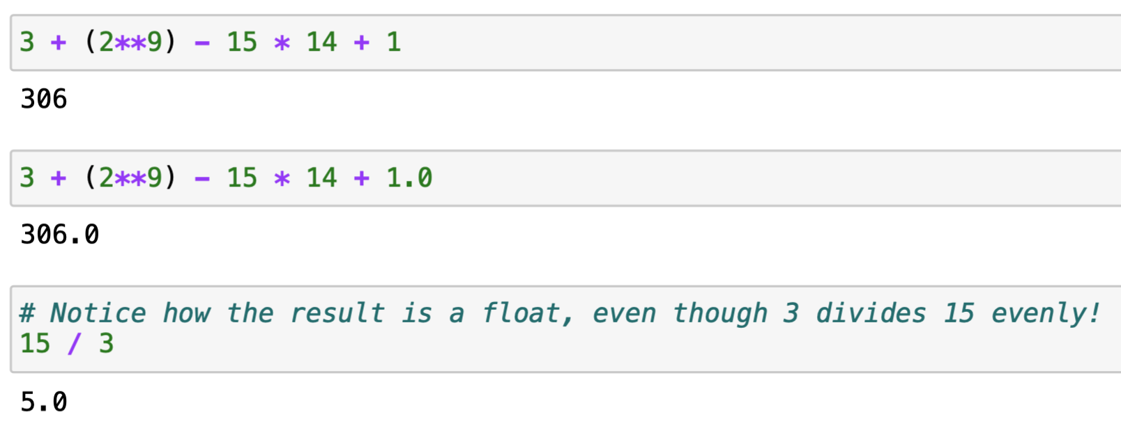
Arithmetic operators with ints and floats
When you add, subtract, and multiply int’s, the result will always be an int.
Anytime you use a float in a calculation, the result is a float.

Slide 15






Two Different Division Operators + Modulo
When you add, subtract, and multiply int’s, the result will always be an int.
Anytime you use a float in a calculation, the result is a float.
Python has several division-related operators:
“Regular” division /
Integer division, //
What is the modulo operator?
Modulo operator, %

Slide 16
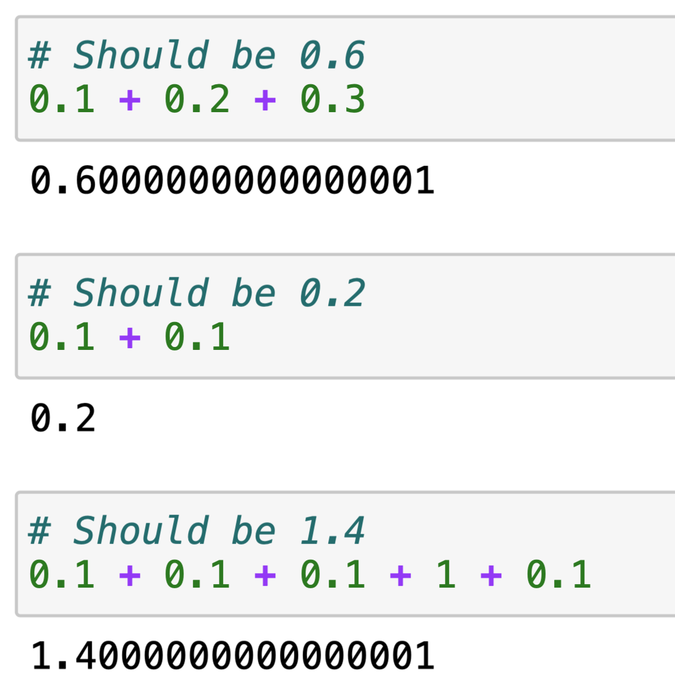
The Pitfalls of Floating Point
Sometimes when performing calculations with floating point numbers, you will see a small amount of random error added or subtracted to your result.
This is a consequence of how numbers are stored in computers. There’s nothing we can really do about it, but you should be aware of it!

Slide 17
Errors…

Slide 18
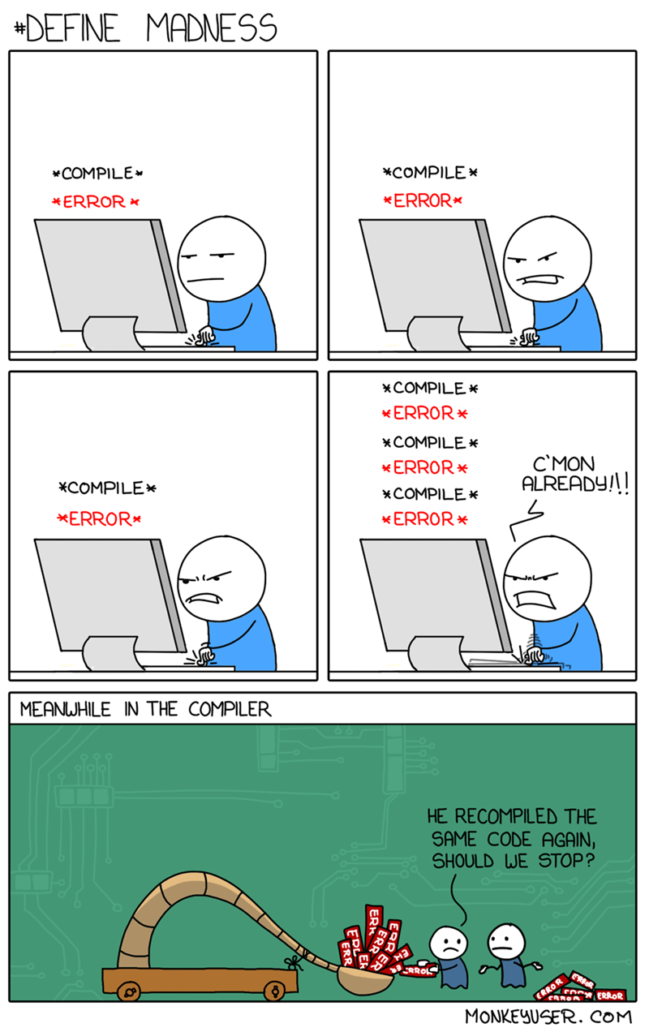
… everyone gets them

Slide 19
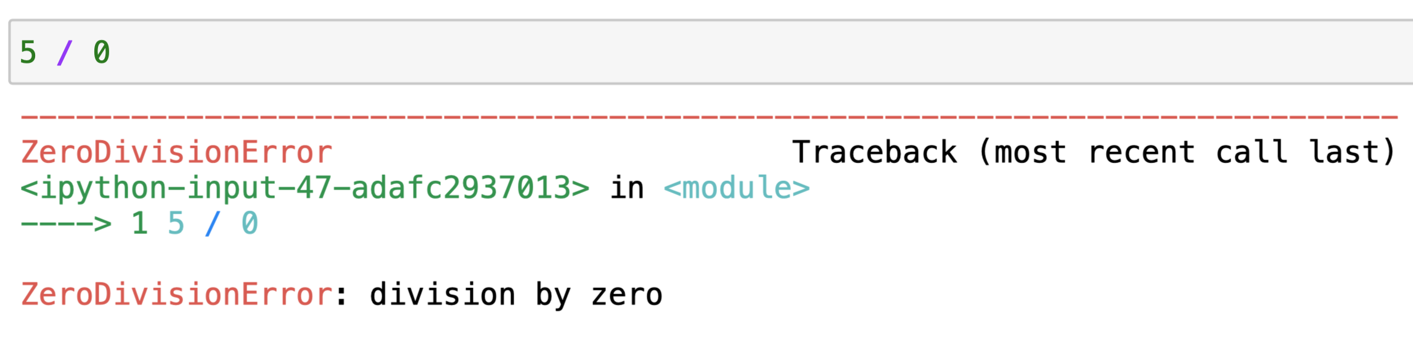
Errors
If we try dividing by 0…
…we get an error message.
This will happen a lot: one objective in this class is to learn how to interpret and address error messages.

Slide 20
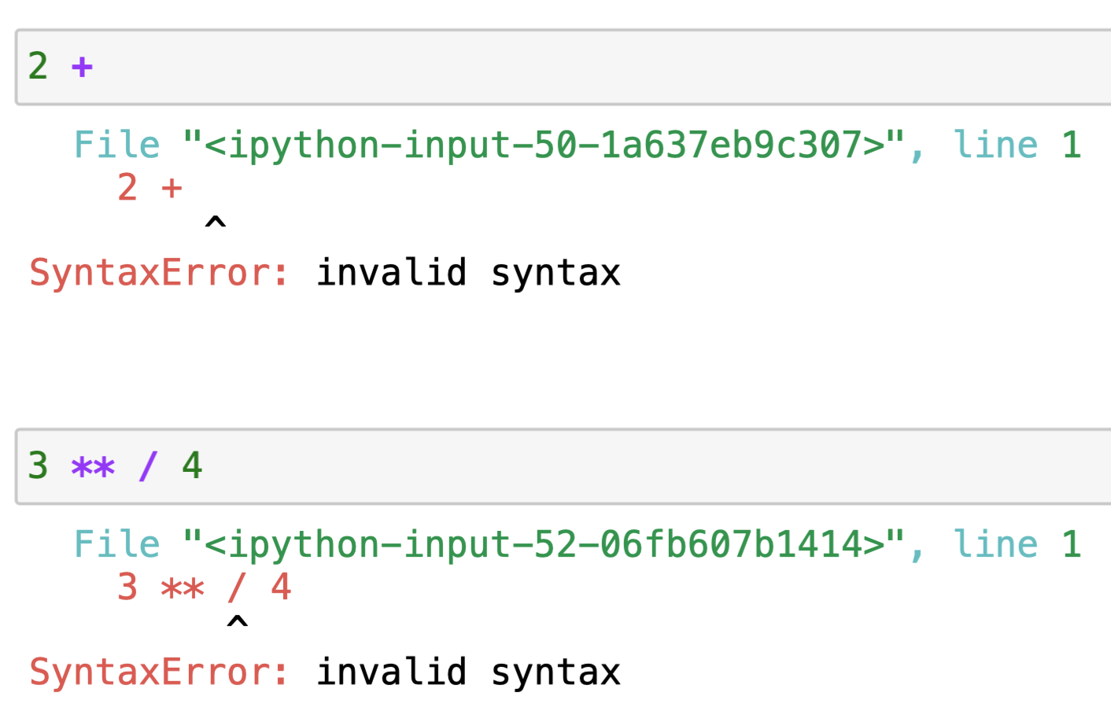
Syntax errors
Syntax errors create nonsensical Python code. These errors will soon become your close friends.
Explore the code! Experimentation is encouraged. Hypothesize, edit/run code, and observe results
Notice that the error message tells you where in your code the error occurred (with a line number and an arrow). Use that!

Slide 21
In Conclusion…

Slide 22
Summary
Comment your code where necessary.
Comments help make our code more readable and sustainable.
It will make it easier for you and for others to understand what the code is doing.
Python stores integers and decimals in different ways.
Be aware when integers and decimals are being created and called.
Be aware when using operators on integers results in decimals.
You may get error messages along the way.
They will happen VERY frequently.
When our code has an error, the error message can help us fix it.

Slide 23
Recap
Next Time
Commenting your code
Data types (int and float)
Errors
Functions
More Data types
Names and Assignment Statements

Slide 24
Week 1
Announcements!
Make sure to fill out the welcome survey, posted on Ed!
First lab is on Wednesday
Quick Checks start Wednesday
Make sure you can access Ed and Gradescope
If not, email James
Happy 4th of July!

